Slide 1

Symptomatic Diagnosis in Mental Health
Developing an efficient machine learning model to classify mental health status from textual statements using Natural Language Processing (NLP) and ensemble learning plus an interactive Streamlit app for real-time predictions.

Slide 2

PROJECT OVERVIEW
The Core Objective
Efficient Text Classification
Ensemble Approach
Utilize a powerful ensemble combining Random Forest, Logistic Regression, and Decision Tree classifiers.
Build a system that can analyze and classify statements into different mental health categories.
Leveraging NLP
Develop an ML model to classify user-input text as Depression, Anxiety, or Normal and deploy an interactive Streamlit app for real-time predictions.
Apply Natural Language Processing techniques for feature extraction and context analysis.

Slide 3
Problem Statement
People often express mental state in texts or social posts that go unnoticed. Early detection via automated text analysis can enable timely support and intervention

Slide 4

Dataset Preparation and Preprocessing
The combined dataset of textual statements is rigorously processed to ensure model quality.
Data Cleaning
Removal of stopwords and punctuation to focus on meaningful terms.
Feature Extraction
TF-IDF vectorization converts text into numerical features for machine learning.
Class Imbalance
Random Oversampling is applied to balance the distribution of mental health categories.

Slide 5
METHODOLOGY
The 8-Step Prediction Process
01
02
Load & Clean Data
Remove Stopwords
03
04
TF-IDF Vectorization
Encode Labels
05
06
Split Data (Train/Test)
Train Base Models
07
08
Combine via Voting Classifier
Evaluate Performance

Slide 6



Core Algorithms: A Synergistic Approach
We selected three base models, each contributing unique strengths to the final ensemble.
Random Forest
Logistic Regression
Decision Tree
Tree-based ensemble that reduces overfitting by averaging results from multiple decision trees.
A linear model used for classification based on probability estimation.
A simple, powerful non-linear model that recursively splits data to classify samples.

Slide 7


Ensemble Power: The Voting Classifier
The Voting Classifier combines predictions from the base models using soft voting, averaging probabilities to make robust final predictions.
This ensemble method enhances overall performance, generalization, and robustness compared to any single model.

Slide 8



EVALUATION
Model Performance Metrics
Performance is evaluated using the classification report and the confusion matrix.
Classification Report
Indicates the model's effectiveness using precision, recall, and F1-score across different classes.
Confusion Matrix
Provides crucial insights into class-wise prediction accuracy (true positives, false negatives, etc.).

Slide 9
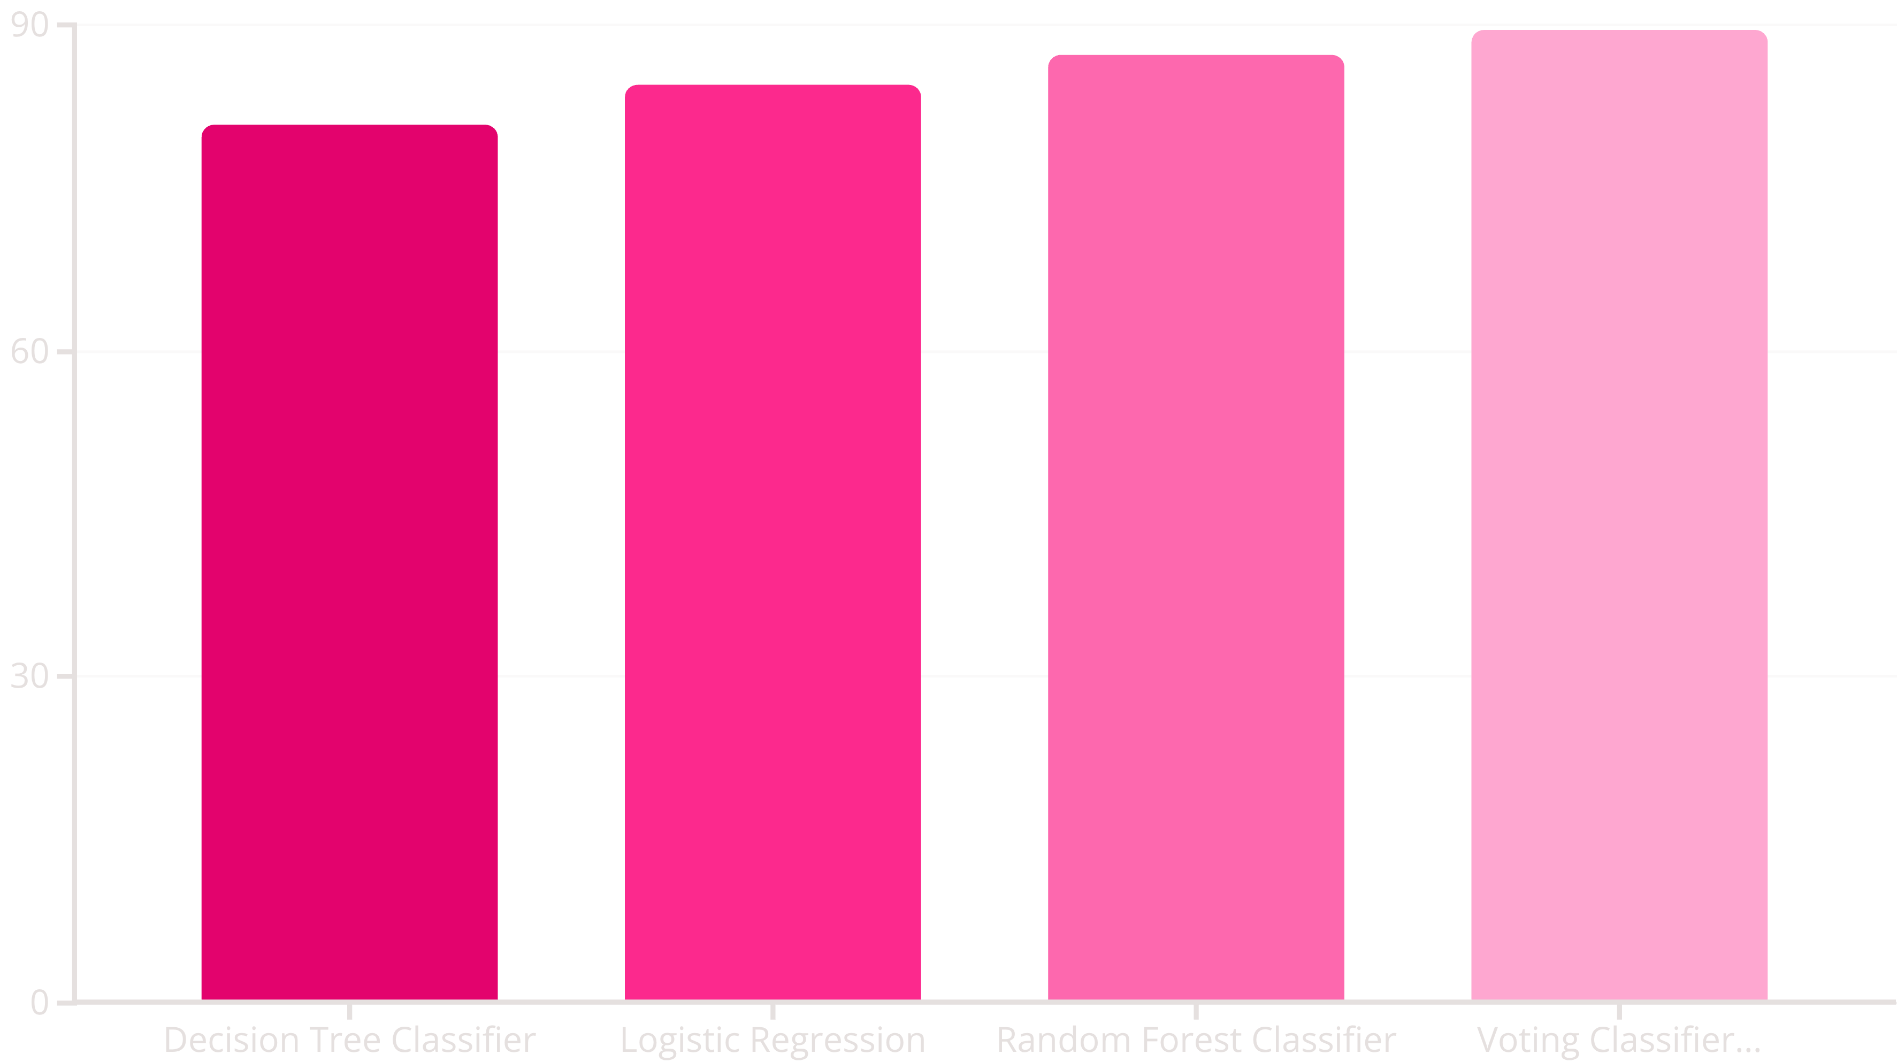
Accuracy Comparison: Ensemble vs. Individuals
The ensemble Voting Classifier achieves the highest overall accuracy (89.6%), validating the effectiveness of combining multiple models for improved generalization.

Slide 10

Sample Prediction Results
The model successfully classifies statements into relevant mental health statuses.
1
2
3
Statement:
Statement:
Statement:
"I feel anxious and stressed about my work."
"I am feeling very happy today."
"Sometimes I feel really low and depressed."
Predicted: Happy
Predicted: Anxiety
Predicted: Depression

Slide 11
Web Application (Deployment)
Streamlit Interface
Interactive app where users enter sentences and receive predictions: Anxiety / Depression / Normal.
Integrated with Ngrok for public access
Lottie animations for engaging visualization

Slide 12
Conclusion & Future Deployment
Ensemble Success
Planned Upgrades
The project successfully demonstrates that the Voting Classifier significantly enhances prediction accuracy for mental health status from text data.
Add deep learning (BERT, LSTM), sentiment scoring, multilingual classification, and mobile-friendly UI.

Slide 13
Thank You

